Slide 1
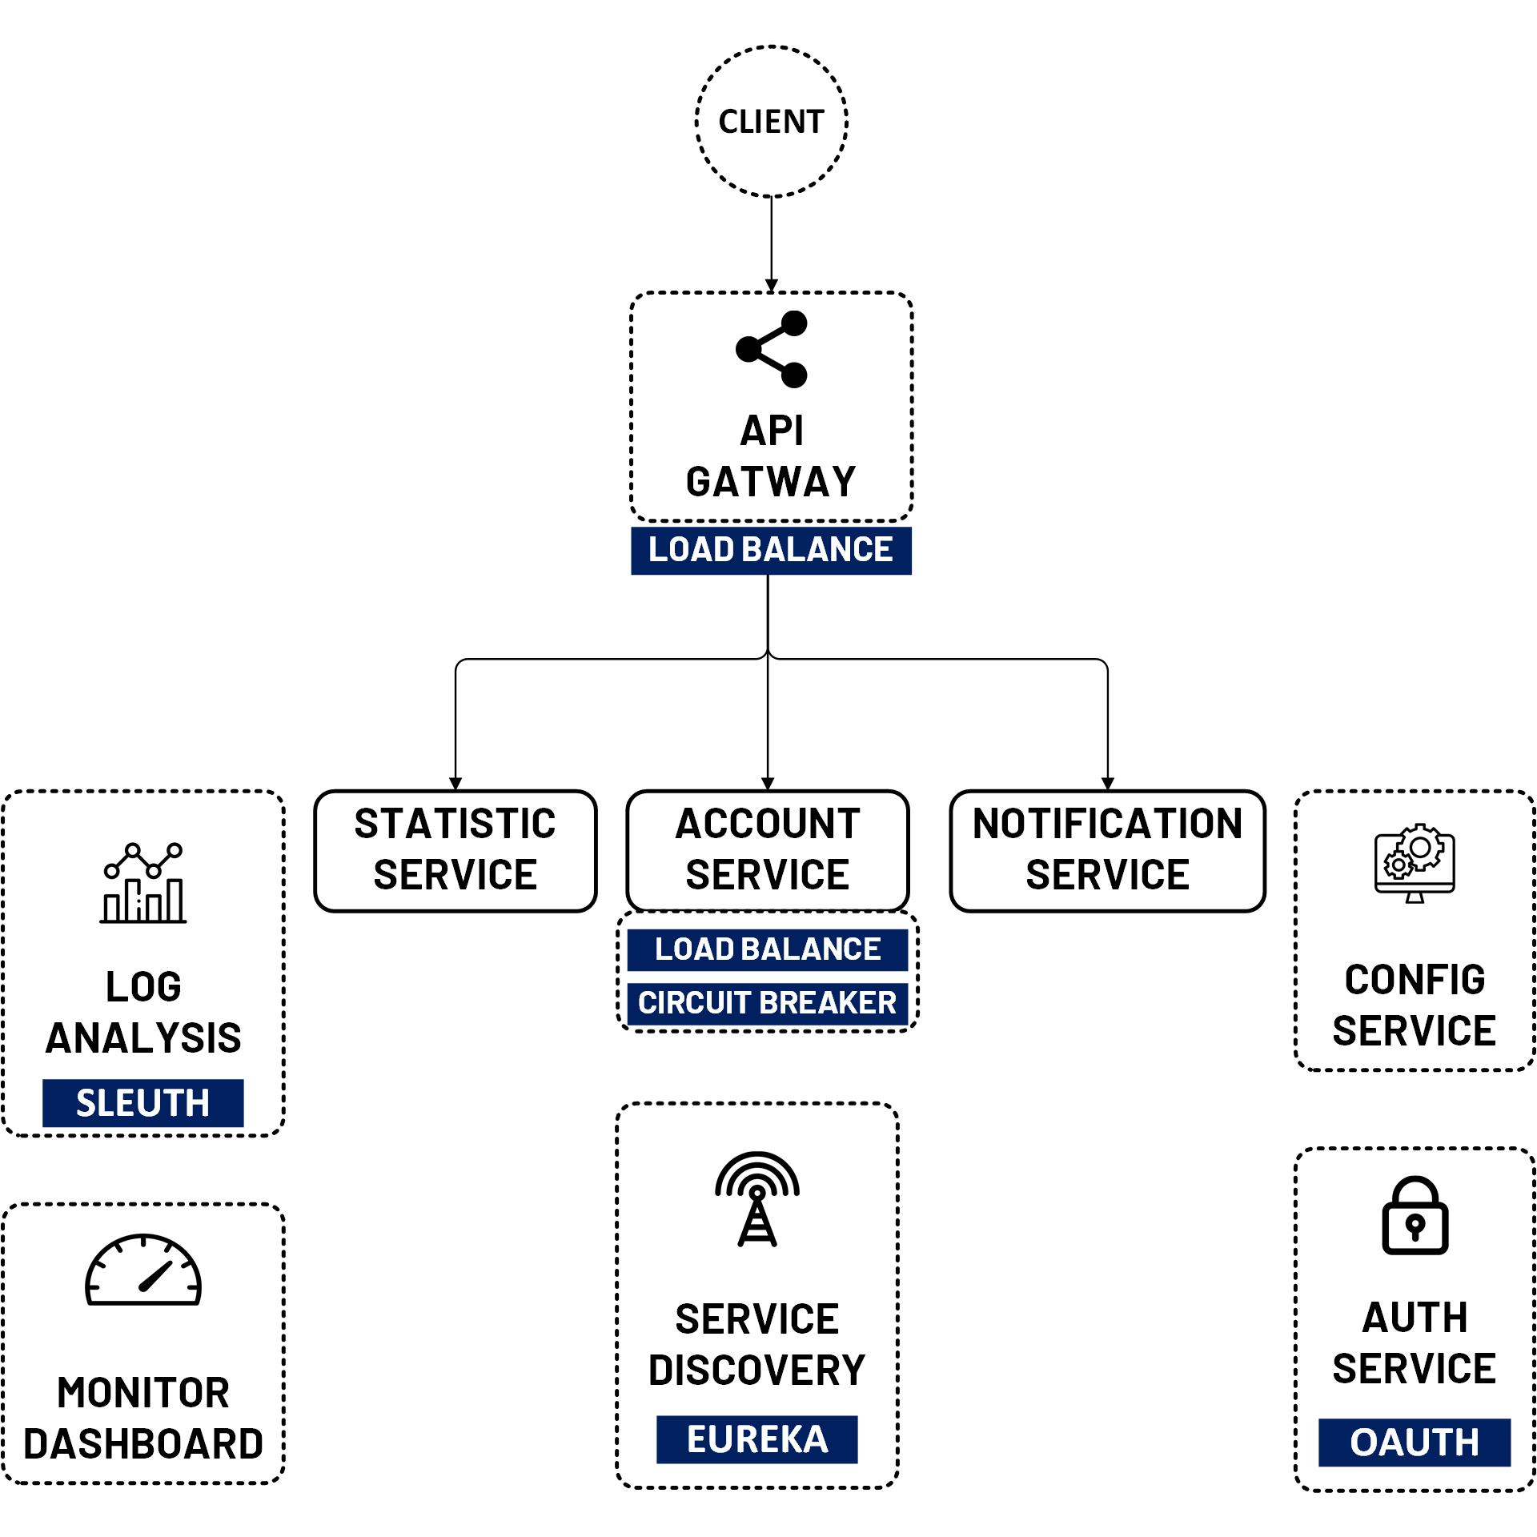

OAuth 2 Security Client Credentials Grant
www.jmaster.io/course/microservices-with-spring-cloud

Slide 2
Client Credentials Grant
Client obtains an access token on behalf of itself, not end user
Used by clients to access their own resources rather than to access a user's resources.

Slide 3
